Slide 1
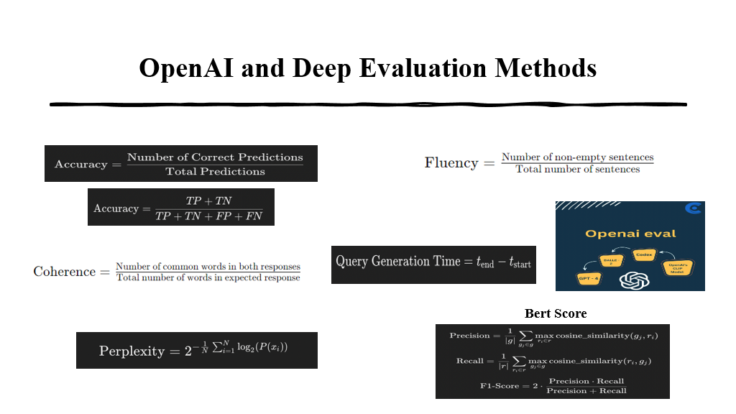
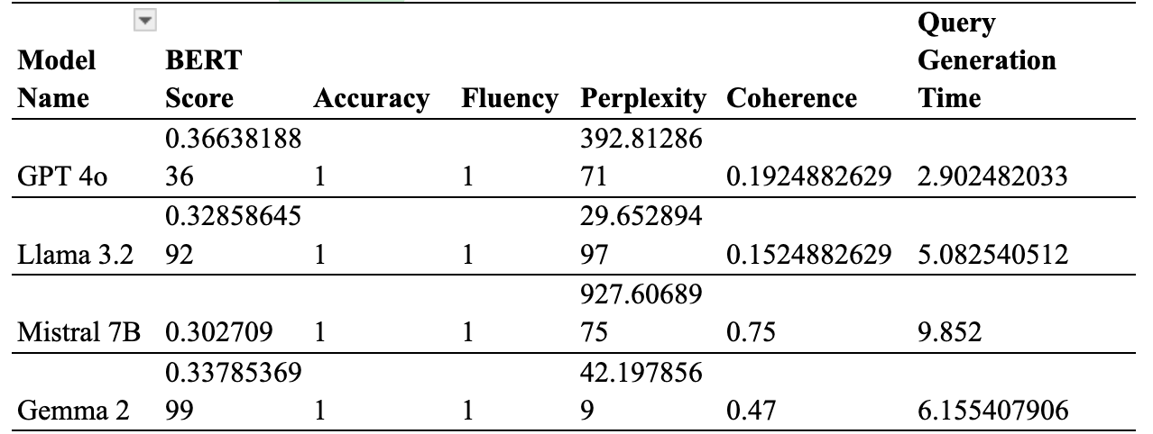
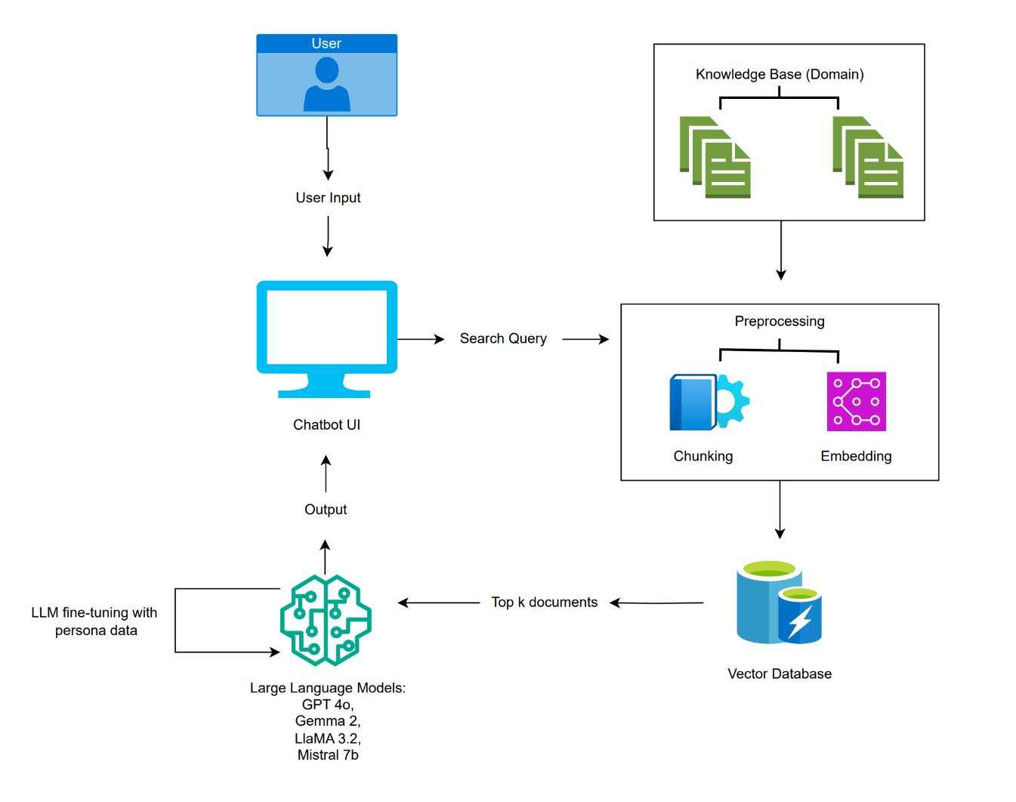
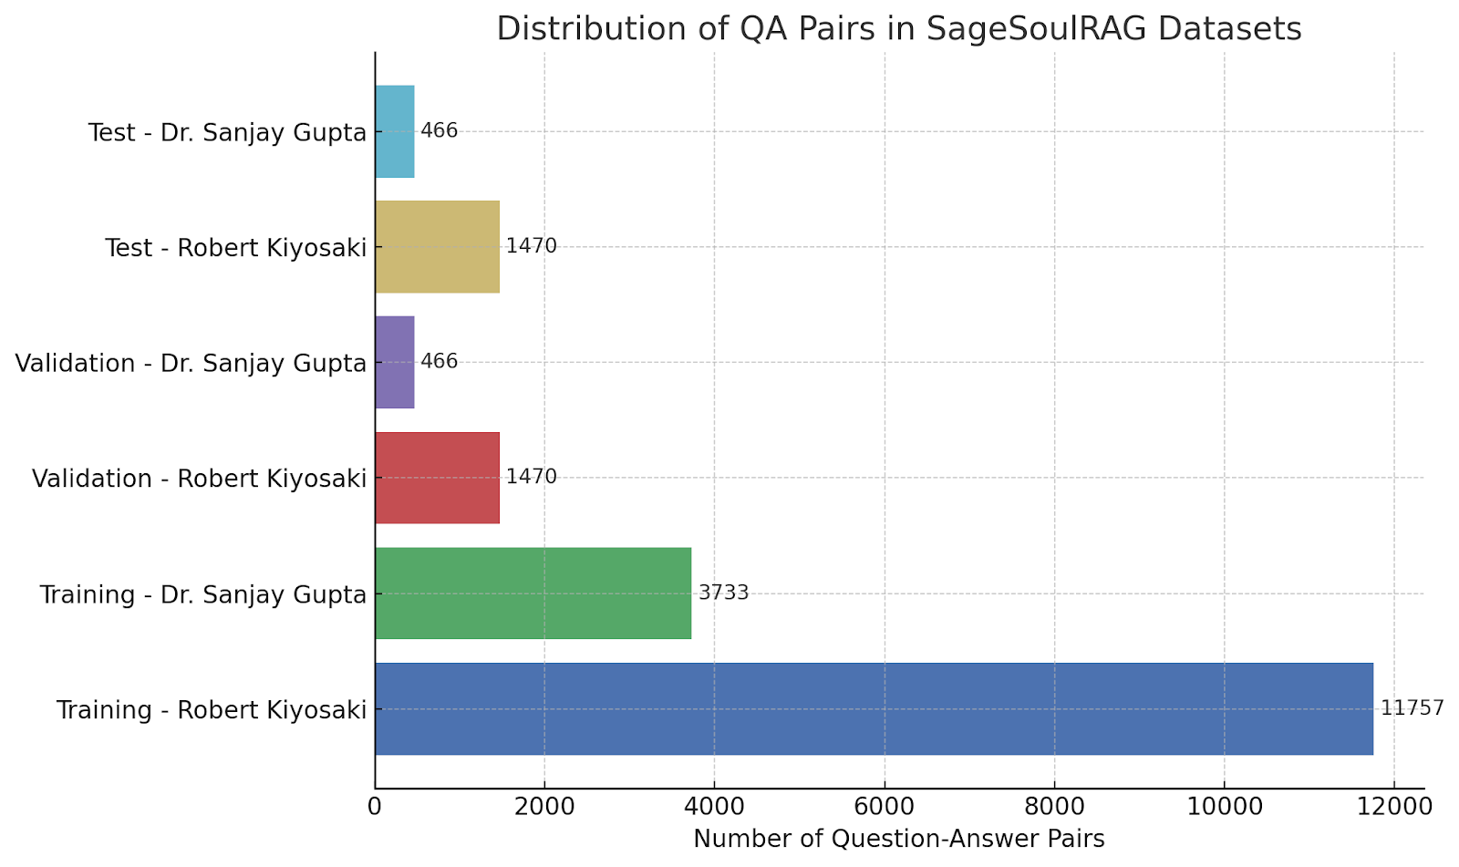
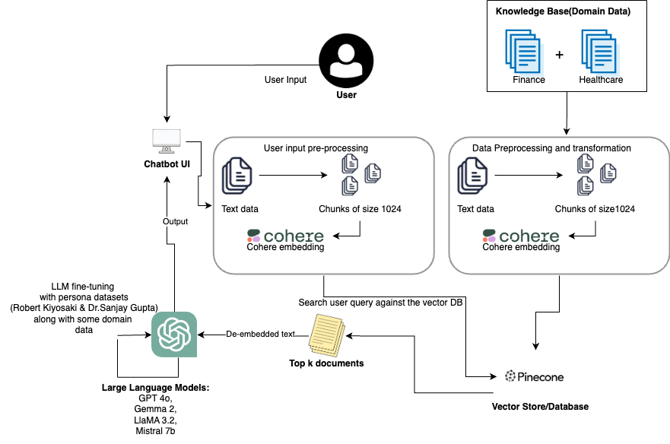
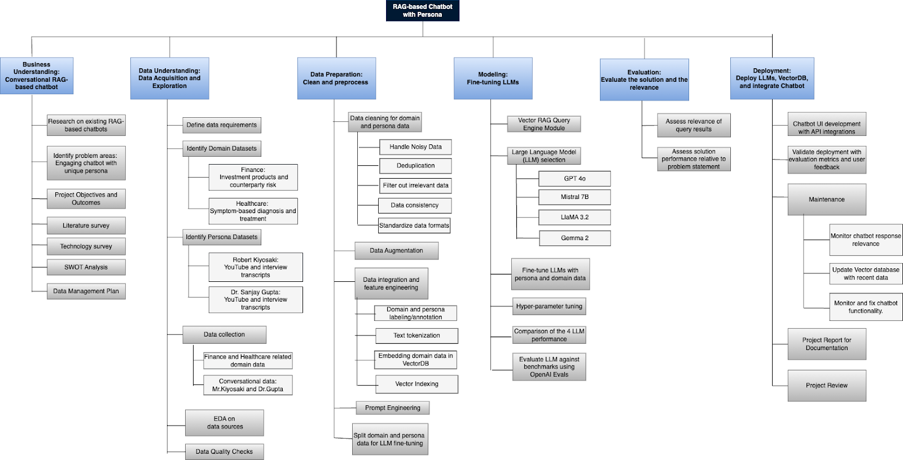
Applied Data Science Department
SageSoulRAG: RAG-based Chatbot with Personality
Project Advisor: Simon Shim
Rathnakar, AradhyaAlva
Basavaraju, BhavanKumar
Panda, Mahamaya
ReddyChappidi, ReddySaketh
KadariMallikarjuna​, ShashiKumar
Introduction
Analysis and Results
coherence with a score of 0.75, though it struggles with high perplexity (927.61) and slow query generation (1955.78 seconds). Gemma 2 balances between these metrics with a BERT score of 0.337, a moderate perplexity of 42.20, and a coherence score of 0.47, though its query generation time of 6.16 seconds is the longest. The comparison table is shown below.
In the evolving landscape of Conversational AI, traditional chatbots often fail to deliver engaging and human-like interactions. SageSoulRAG addresses this gap by creating a Retrieval-Augmented Generation (RAG)-based chatbot that mimics the personas of finance expert Robert Kiyosaki and medical journalist Dr. Sanjay Gupta. This system leverages advanced large language models, including GPT 4o, LlaMA 3.2, Gemma 2, and Mistral 7B, integrated through APIs to provide accurate and personality-driven responses for finance and healthcare domains.
Problem Statement and Objectives
The project "SageSoulRAG: RAG-based Chatbot with
Personality" addresses the limitations of traditional chatbots that
lack human-like traits, often resulting in robotic and impersonal
interactions. By incorporating personalities modeled after finance
expert Robert Kiyosaki and medical expert Dr. Sanjay Gupta, the
project aims to deliver expert-level, personalized advice in
finance and healthcare. The chatbot blends natural language
processing (NLP) and machine learning techniques to mimic
these personas, providing users with an engaging and
informative experience.
Project Data
Data Sources and Preparation: The knowledge base combines static sources such as books and articles with dynamic data streams accessed via APIs. The finance dataset contains 11,757 question-answer pairs derived from investment banking and market trends, while the healthcare dataset features 3,733 pairs related to symptom diagnosis and treatment. Persona-specific content, such as transcripts, interviews, and authored books, was curated to emulate the experts’ distinct styles. The datasets underwent rigorous cleaning, augmentation, and embedding processes to prepare them for model training and retrieval. A visualization of the training, validation, and test data split is shown below.
Results
Model Performance Evaluation: The chatbot’s performance was assessed using OpenAI Eval and DeepEval frameworks. Metrics such as accuracy, fluency, coherence, Precision, Recall, and F1-scores highlighted the system's ability to generate reliable, contextually relevant responses. BERT Scores and Perplexity metrics further demonstrated semantic and predictive accuracy. Human evaluators confirmed the chatbot's fluency and coherence through qualitative ratings, while query generation time metrics verified its suitability for real-time interactions.
The model evaluation compares various language models—GPT-4o, LlaMA 3.2, Mistral 7B, and Gemma 2—across key performance metrics. GPT-4o leads with the highest BERT score of 0.366, indicating strong semantic alignment, and achieves perfect fluency and accuracy, though its perplexity of 392.81 suggests some challenges with word prediction. LlaMA 3.2 performs efficiently with a lower perplexity of 29.65 and a BERT score of 0.328, but its query generation time of 5.08 seconds is longer than GPT-4o's 2.90 seconds. Mistral 7B has the lowest BERT score of 0.302 but excels in
Summary/Conclusions
Technical Approach
The chatbot leverages a Retrieval Augmented Generation (RAG) framework to enhance response accuracy by integrating a robust retrieval system with generative language capabilities. A comprehensive knowledge base was created using the Pinecone Vector Database, which stores domain-specific data (finance and healthcare) alongside persona-based conversational datasets. Advanced preprocessing techniques, including tokenization, normalization, and embedding, ensure efficient data handling. Four large language models (LLMs)—GPT-4o, LlaMA 3.2, Gemma 2, and Mistral 7B—are fine-tuned to align with the specific communication styles of the personas. A system architecture diagram below illustrates the integration of LLMs, Pinecone database, and the RAG framework.
Evaluation Metrics
The chatbot's performance was rigorously assessed using OpenAI Eval and DeepEval frameworks to ensure its reliability and alignment with project goals. The metrics included accuracy, fluency, and coherence. Quantitative metrics such as Precision, Recall, and F1-score are employed to evaluate the classification tasks, ensuring balance between false positives and false negatives. The BERT Score and Perplexity metrics provided insights into the semantic and predictive accuracy of the responses, while human evaluators qualitatively rated fluency and coherence on a predefined scale. Additionally, Query Generation Time is used as a critical metric to measure the system's responsiveness, ensuring suitability for real-time applications.
The SageSoulRAG project successfully developed a Retrieval Augmented Generation (RAG)-based chatbot with distinct personas, Robert Kiyosaki and Dr. Sanjay Gupta. By integrating advanced language models and utilizing a robust data retrieval system, the chatbot provided domain-specific expert advice in finance and healthcare, ensuring accurate, fluent, and contextually relevant responses. The evaluation results showcased high performance across various metrics, with GPT-4o leading in accuracy and fluency, while Mistral 7B excelled in coherence.
The SageSoulRAG chatbot demonstrated significant advancements in conversational AI by mimicking expert personalities and delivering tailored responses. The use of fine-tuned LLMs and efficient data retrieval techniques helped achieve robust performance, making the chatbot a valuable tool for personalized guidance in complex domains like finance and healthcare. Future work may focus on enhancing model efficiency and expanding its application to other fields.
Implements robust data preprocessing with tokenization, normalization, and embedding.
Fine-tunes models on persona-specific datasets for expert-level responses.
Optimizes retrieval using Pinecone Vector Database and rigorous evaluation metrics.
Key References
Methodology
[1] An in-depth guide to building a custom GPT-4 chatbot on your data. Mercity AI, Pranav. (n.d.). https://www.mercity.ai/blog-post/custom-gpt-4-chatbot
[2] Anil, R., Dai, A. M., Fırat, O., Johnson, M., Lepikhin, D., Passos, A. M. a. D., Shakeri, S., Taropa, E., Bailey, P., Chen, Z., Chu, E., Clark, J. H., Shafey, L. E., Huang, Y., Meier-Hellstern, K., Mishra, G., Moreira, É. R., Omernick, M., Robinson, K., . . . Wu, Y. (2023). Gemma 2 Technical Report. arXiv (Cornell University). https://doi.org/10.48550/arxiv.2305.10403
[3] Bonnet, A. (2024, October 8). From vision to edge: Meta’s Llama 3.2 explained. Encord. https://encord.com/blog/lama-3-2-explained/
[4] DeepMind\authfootnotemark1, G. T. G., Team, G., & DeepMind\authfootnotemark1, G. (n.d.). Gemma: Open models based on Gemini Research and Technology. https://arxiv.org/html/2403.08295v1
[5] DeepMind\authfootnotemark1, G. T. G., Team, G., & DeepMind\authfootnotemark1, G. (n.d.). Gemma: Open models based on Gemini Research and Technology. https://arxiv.org/html/2403.08295v1
The SageSoulRAG chatbot employs a structured approach combining advanced data processing, model fine-tuning, and efficient deployment. The methodology ensures accurate, engaging, and domain-specific responses through the integration of cutting-edge technologies.
Data Collection & Processing: Domain-specific data (finance, healthcare) and persona conversational data are collected. Preprocessing techniques like cleansing, tokenization, normalization, and embedding are applied for efficient storage in the Pinecone Vector Database.
Model Training: Large language models (GPT 4o, LlaMA 3.2, Gemma 2, Mistral 7B) are fine-tuned using persona-specific datasets to emulate distinct communication styles.
System Integration: The chatbot is deployed on Hugging Face with a Streamlit interface, facilitating real-time, user-friendly interaction with scalable architecture.
Acknowledgements
We extend our deepest gratitude to Dr. Simon Shim and Dr. Lee C. Chang for their invaluable guidance and expert advice throughout the course of this project. Their insights and expertise in the field of Applied Data Science have been instrumental in shaping our approach and methodologies. Their willingness to impart knowledge and provide continuous support has profoundly impacted our academic journey and professional growth. We are truly grateful for their patience, mentorship, and significant contributions to our learning experience and project success.

